Slide 1


COD changes the world
COD – calculator of optimal discounts
www.codtech.ru

Slide 2

COD is an online software package, allowing, according
to the sales volumes data for each of the discounts of
the Discount menu used, entered from the computer
keyboard, to make optimal adjustment of the
value of the applied discounts and ranges,
ensuring the maximum possible increase
in marginal profit or gross revenue.
"The role of prices in a market-driven economy is fundamental, since prices are an indispensable tool in economic calculations ... but the calculations themselves need prices that can be determined only on the market in the real world of exchange."
Jack Ma, Chairman of the Board of Directors of Alibaba Group

Slide 3

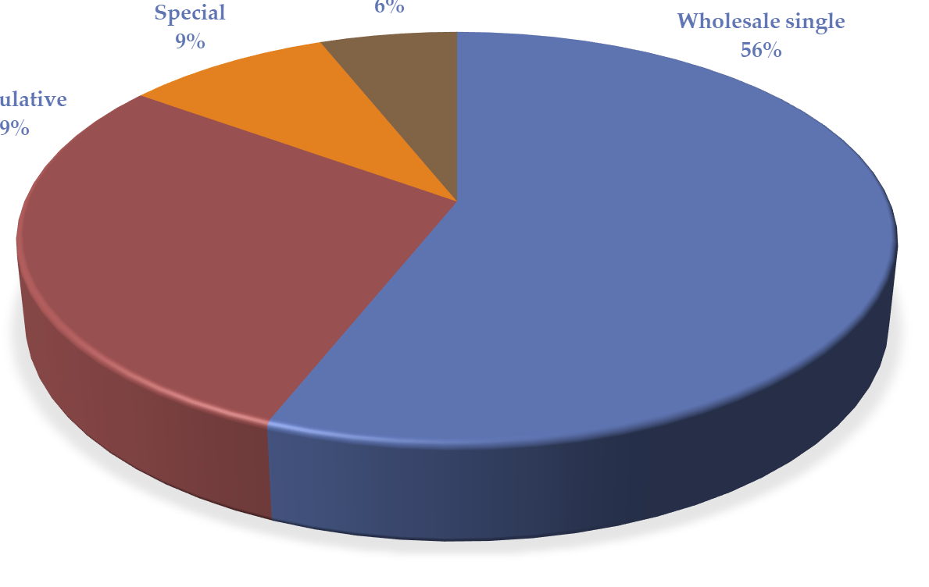

Principle of a Wholesale Discounts Structure Generation
Types of Trade Discounts
The Discount Market
in Russia makes 65.7
trillion rubles
annually

Slide 4

Model Types Used in Calculating Discount menus
Structured
2
3
Input
1
4
6
Output
5
Semi-structured
Input
Output

Slide 5
Market Modeling Technologies
Open
(Classic)
Market monitoring
Optimization
Result
Optimization
Result
Closed
(our own)
Market monitoring

Slide 6
Factors Affecting the Price-Demand
Relationship:
Direct competitors
Manufacturers of substitute products
BRAND
Marketing
complex
Consumer properties
Price
Market
Demand
Distribution channels and demand stimulation
Suppliers of goods and services
Consumer needs
State regulators

Slide 7










COD Implementation into Your Sales System
Dual-circuit adaptable self-learning system
to apply wholesale discounts
Sales parameters determination
Calculation of the optimal discounts system
Recalculation of demand parameters
Investments
Production, supply and distribution
Sales market
Self-determination of buyers in terms of purchase volumes
Profit
…
Total
revenue
Product
offer
Purchase of products
Revenue for each type of discount

Slide 8
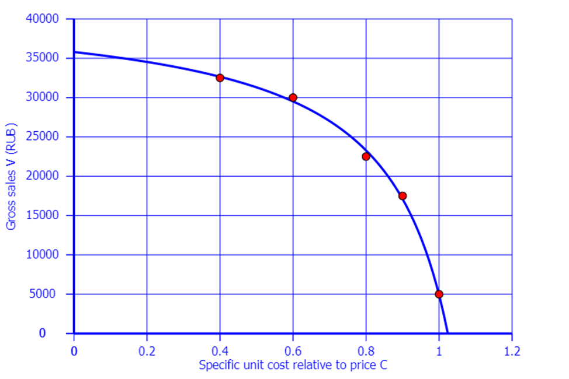
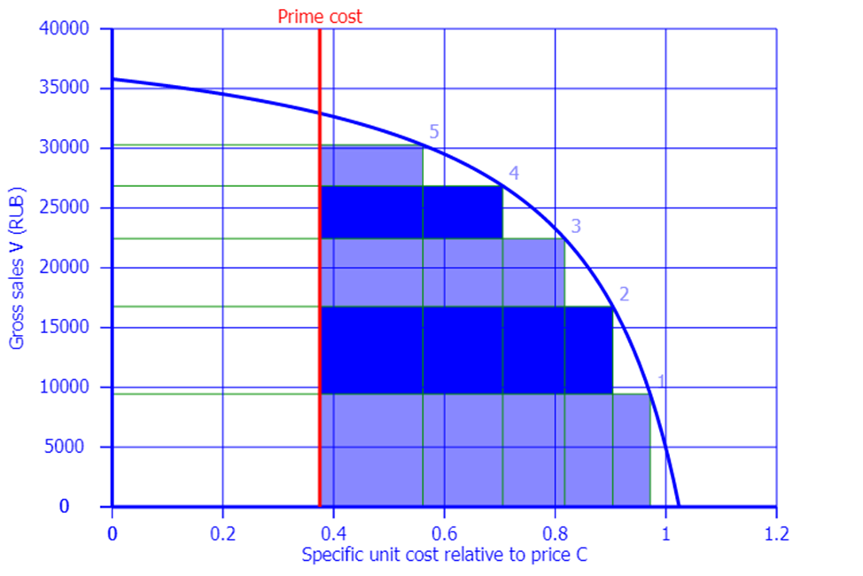
Price Demand Curve and Optimized Price Segments for Services and FMCG Market (Model A)
Price Demand Curve Based on Real Sales Results
Price segments providing maximum demand

Slide 9
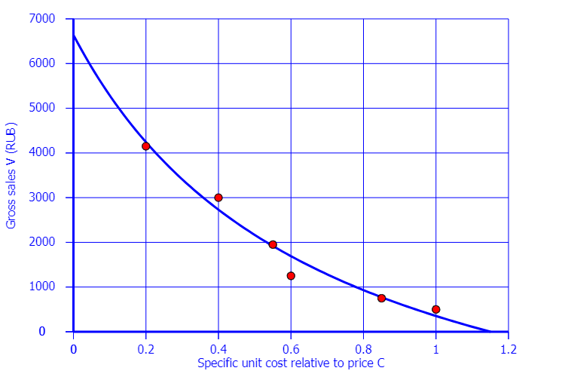
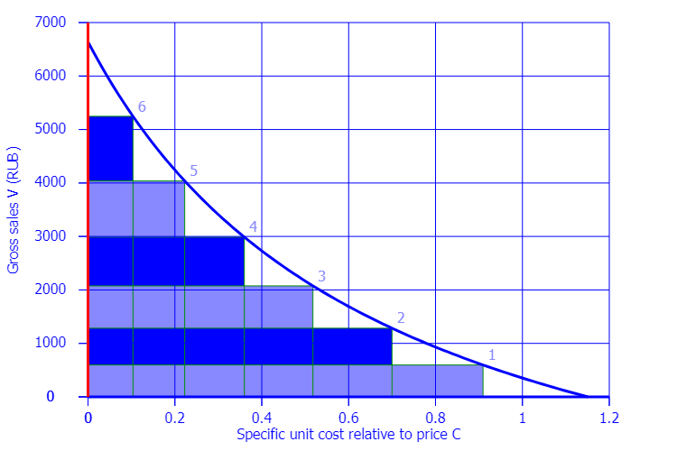
Price Demand Curve and Optimized Price Segments for Durable Goods Market (Model B)
Price Demand Curve Based on Real Sales Results
Price segments providing maximum demand

Slide 10
COD Basic Operation Parameters
The number of bulk discounts in the discount menu (including zero discount) | PCS. | 3 - 10
The number of input data update cycles for calculating the optimal mode with working accuracy | PCS. | 3-5
The number of receipts (single sales) from each of the discounts required for statistical reliability of the result | PCS. | 10-50
The predicted value of the increase / gross revenue (profit margin) with wholesale discounts optimization | % | 10-15 (3-7)

Slide 11
Russian Federation
National emblem
Utility Model
PATENT
№ 200092
DEVICE FOR PRICE MENU ADAPTIVE OPTIMIZATION
Patentees: Erikhov, Mikhail Maksovich (RU), Noskova, Alla Anatolyevna (RU)
Authors: Erikhov, Mikhail Maksovich (RU), Noskova, Alla Anatolyevna (RU)
Application № 3839420191
Utility Model Priority 26th of November 2019
State registration of utility models of Russian Federation 6th of October 2020
Exclusivity period for the utility model expires 26th of November 2029
Head of the Federal service on Intellectual Property
/signature/ G.P. Ivliev

Slide 12

Thank you for the attention!
Academic supervisor of the project:
Doctor of Technical Sciences Erikhov, M.M.
erikhovm@gmail.com
tel.: +7-931-307-44-03

